Slide 1

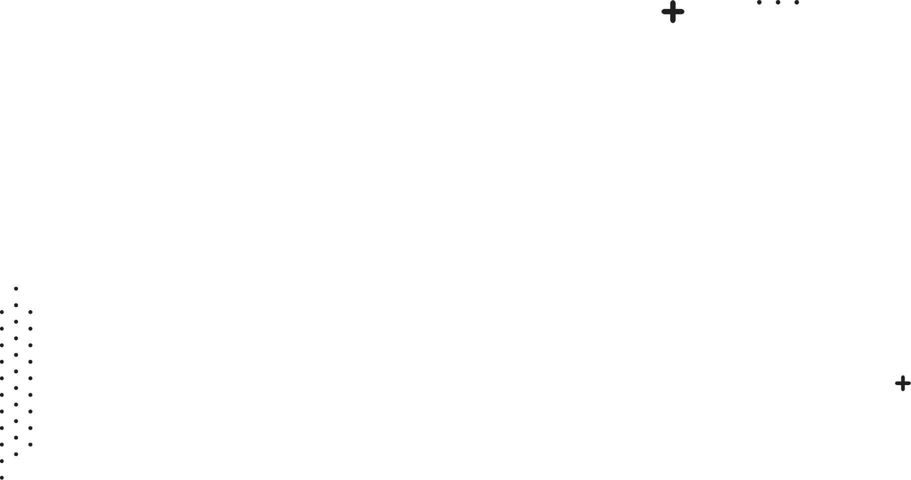
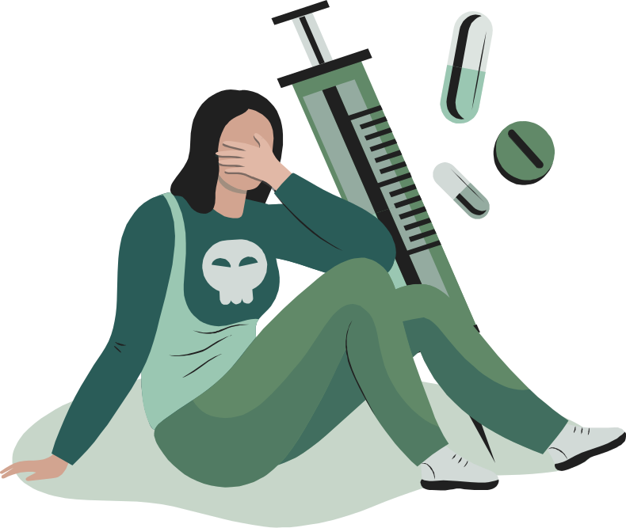
DIA-1
Drug Consumption Analysis & Predictions
Realized by:
Hamza HALINE
Joshua BORNET
YAHYA BOUAYAD

Slide 2

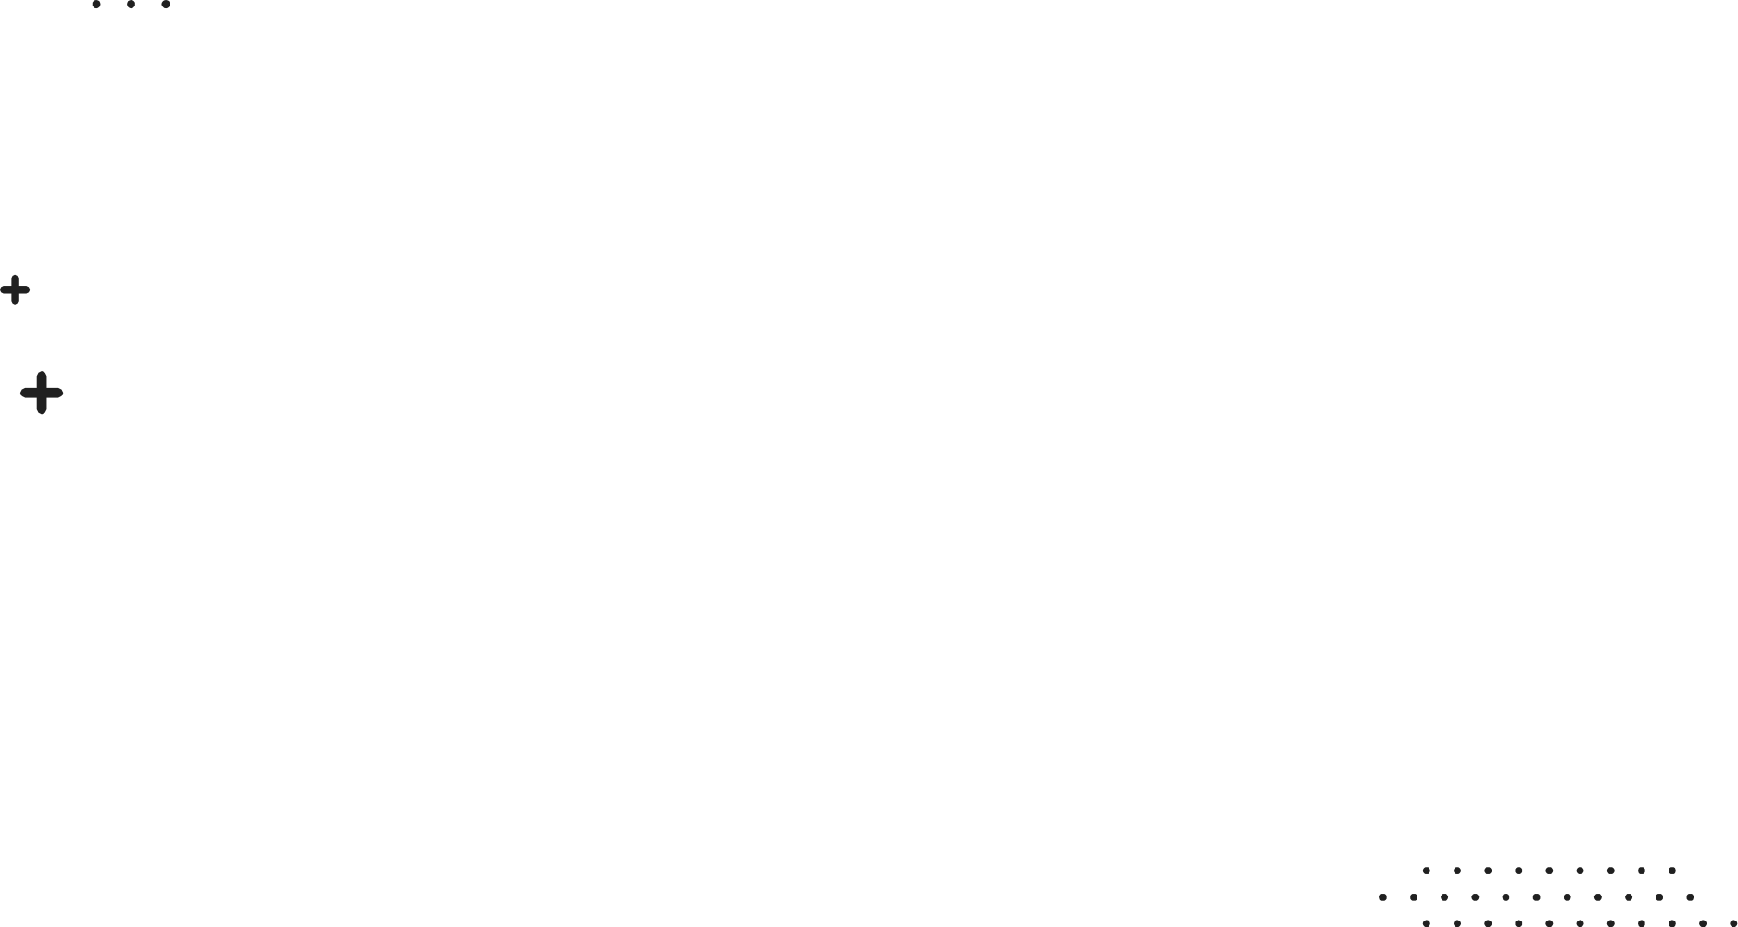
Table of contents
01
02
03
Introduction
Data Pre-Processing
and
Data visualisation
Modeling
04
05
06
Bonus touch
API
Conclusions

Slide 3

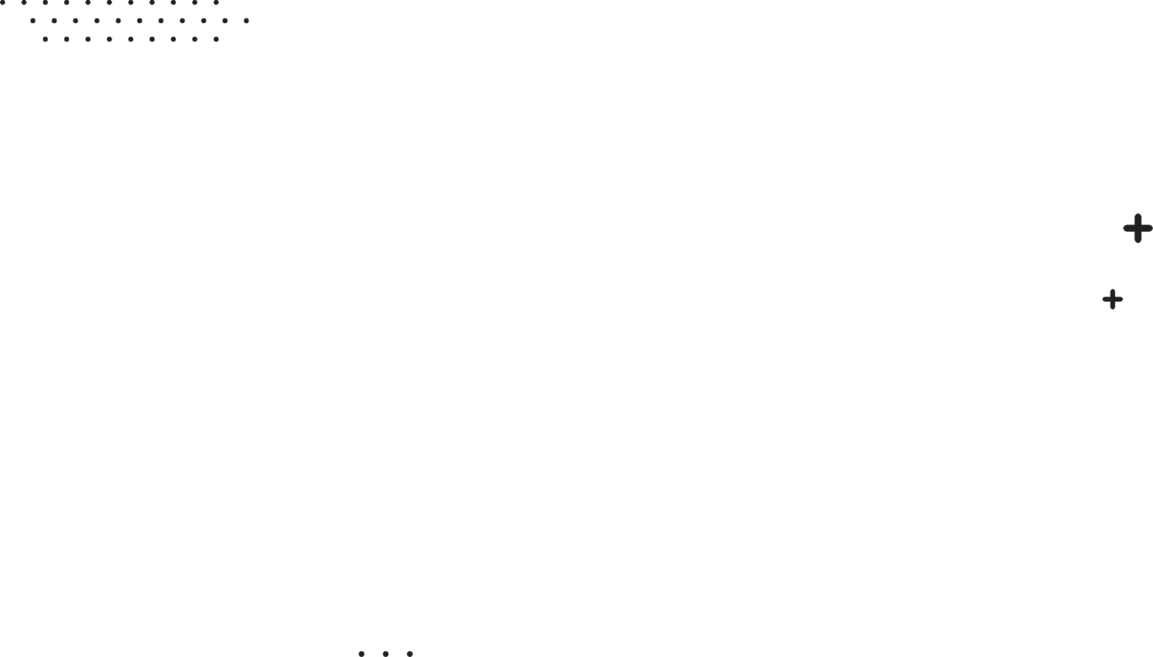
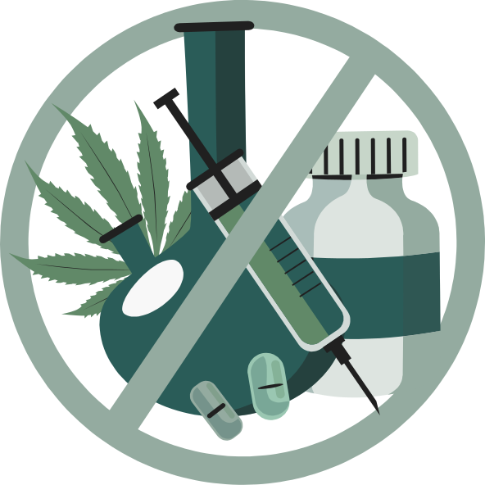
01
Introduction

Slide 4

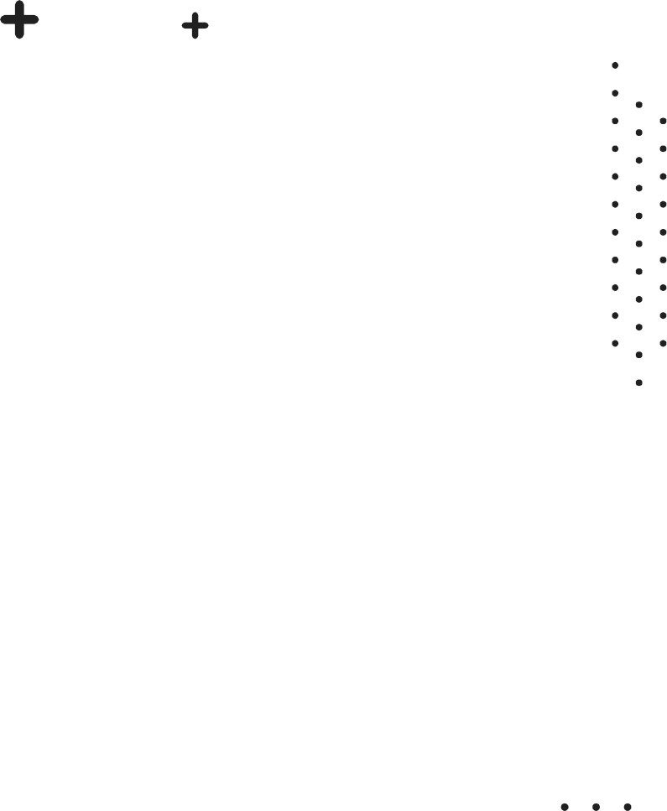
General Introduction:
-In today's dynamic world, understanding the factors influencing drug consumption patterns is of paramount importance for public health, education, and policy-making.
-The selection of this dataset stems from a deliberate choice to explore the intersection of personality traits, education, demographics, and drug usage patterns.
-Our dataset name is : drug+consumption+quantified.csv
-Link : https://archive.ics.uci.edu/dataset/373/drug+consumption+quantified
Notes:
-In today's dynamic world, understanding the factors influencing drug consumption patterns is of paramount importance for public health, education, and policy-making.

Slide 5
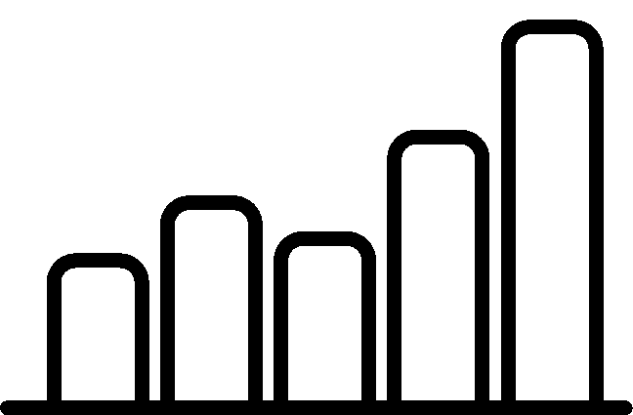
Dataset Presentation:
-Our chosen dataset is a comprehensive repository of information, comprising records for 1885 respondents, each characterized by 30 attributes.
-it contains:
an ID column
5 demographic columns (features)
7 personality traits (features)
18 drugs with their usage frequency (target)
a fake drug called Semeron to verify reliability of answers
-
-Each drug variable can take 6 different values:
CL0 Never Used
CL1 Used over a Decade
CL2 Used in the Last Decade
CL3 Used in the Last Year
CL4 Used in the Last Month
CL5 Used in the Last Week
CL6 Used in the Last Day
-

Slide 6
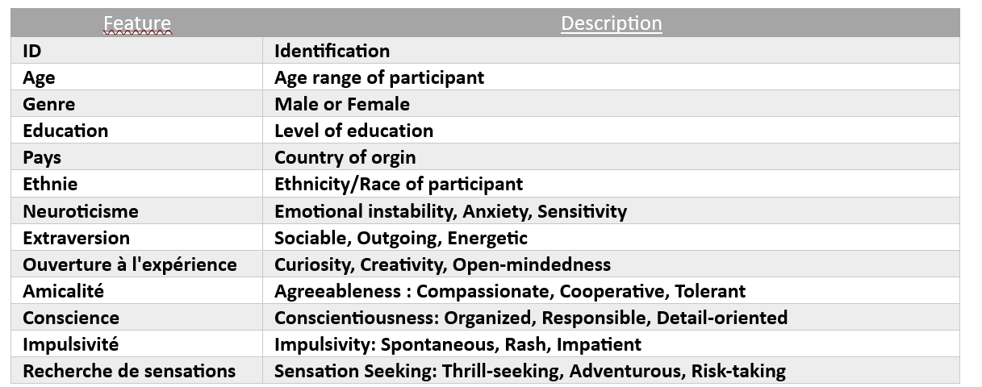
Dataset Presentation:

Slide 7

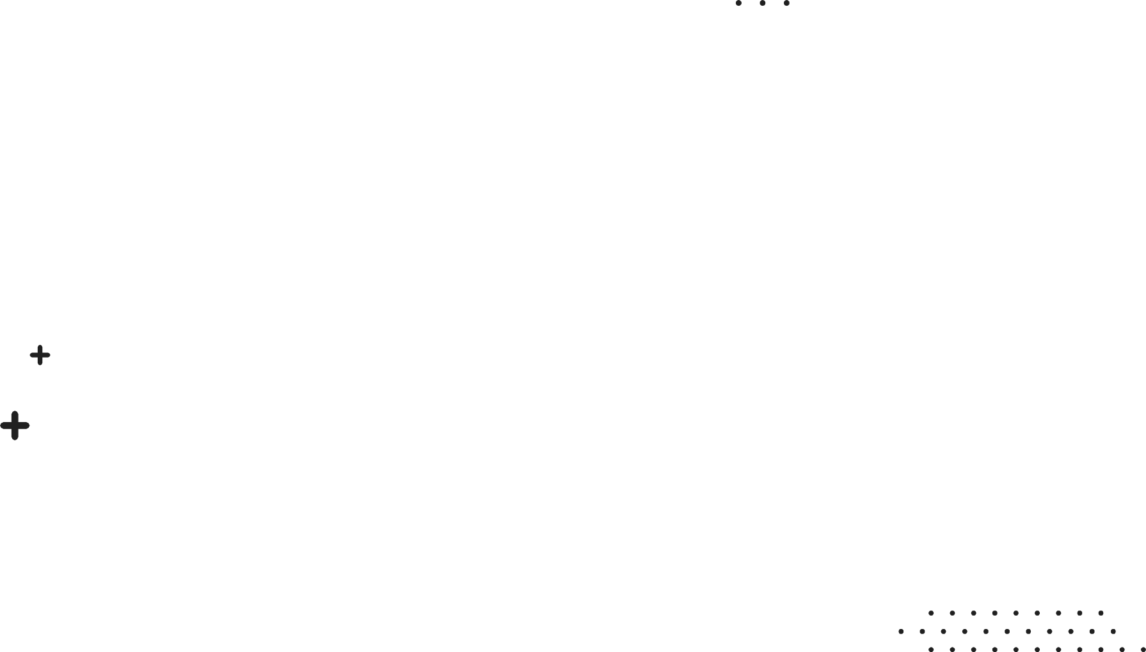
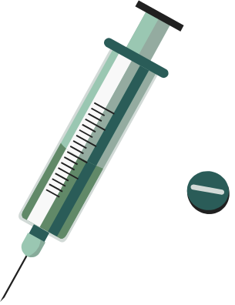

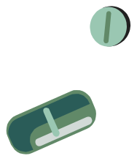
02
Data Pre-Processing
and
Data visualisation

Slide 8

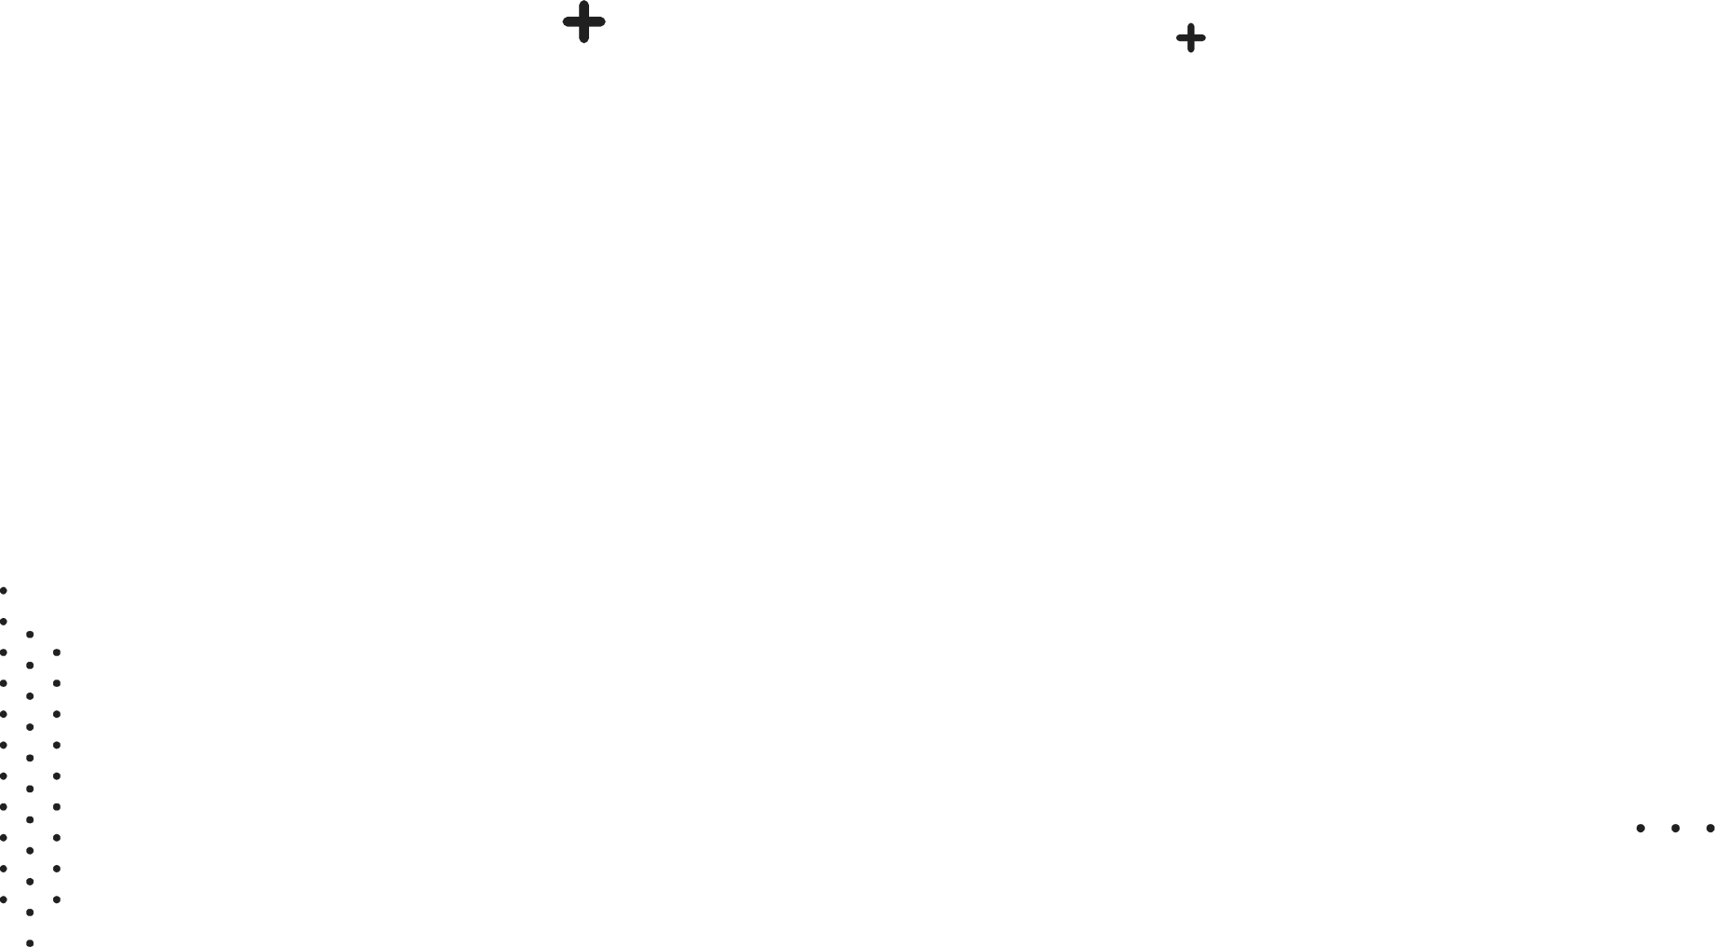
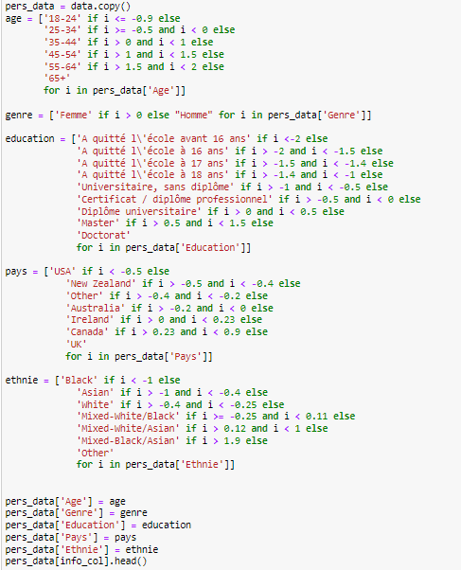
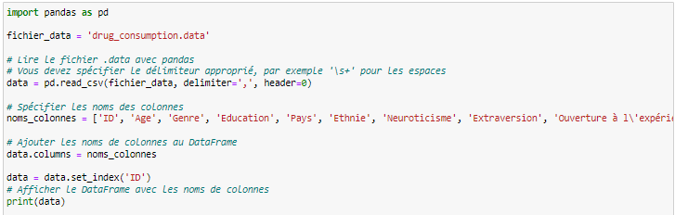
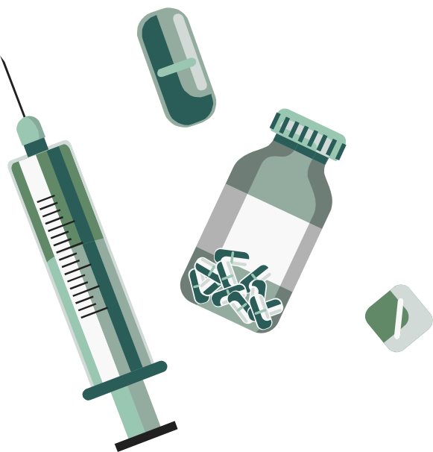
Data loading, exploring and pre-processing:
-Remapper les valeurs par leur vraie signification
-Supprimer toutes les personnes qui prétendent avoir consommé de la semeron
-Créer des listes pour faciliter la gestion des données que nous voulons étudier
-Corrélation entre toutes les données

Slide 9

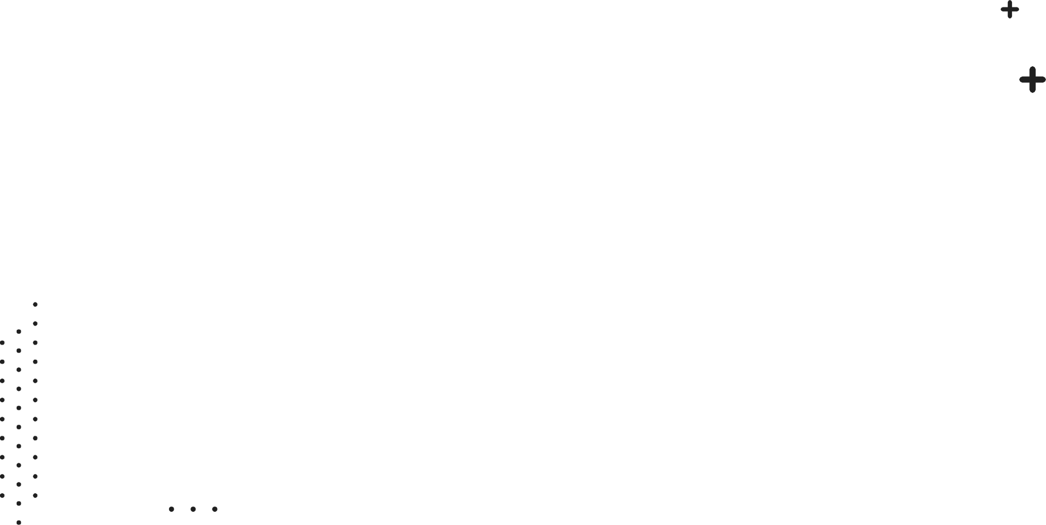
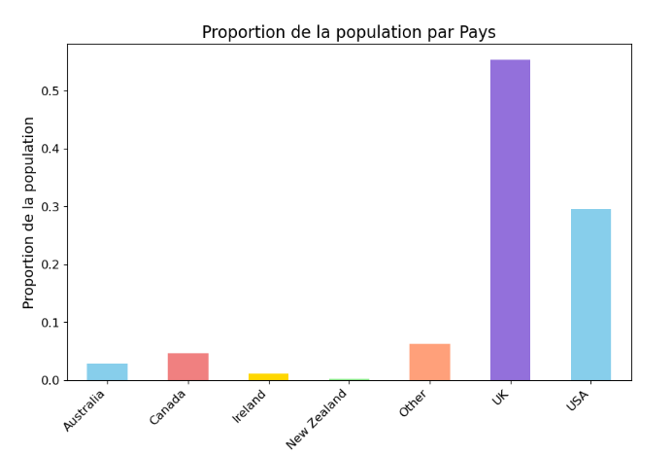
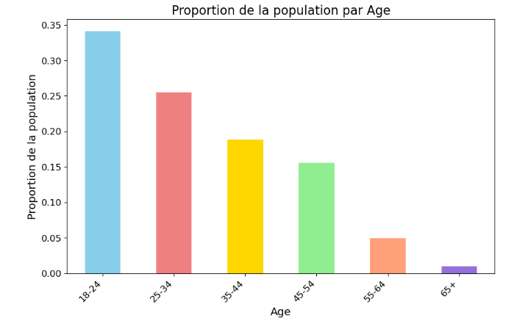
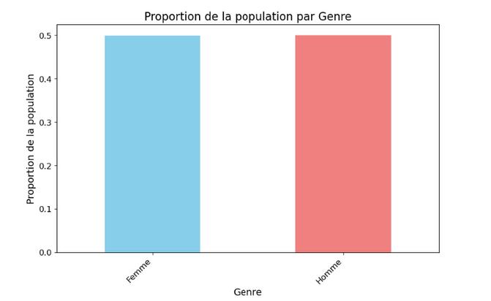
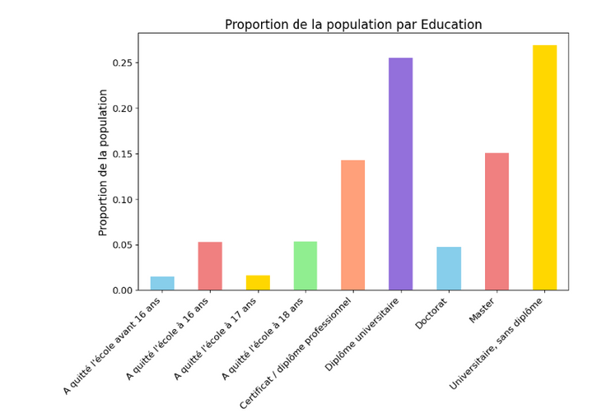
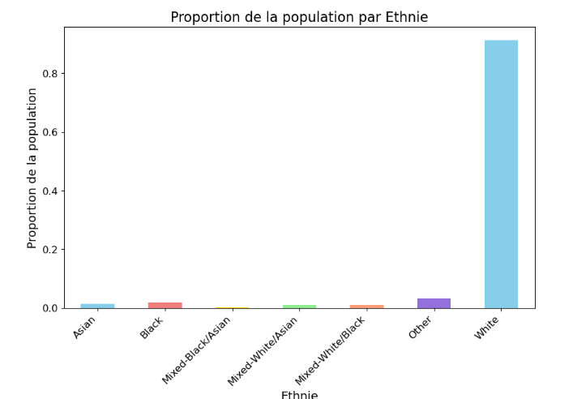
Bar Plots: Proportion of Population by a given Demographic Feature

Slide 10
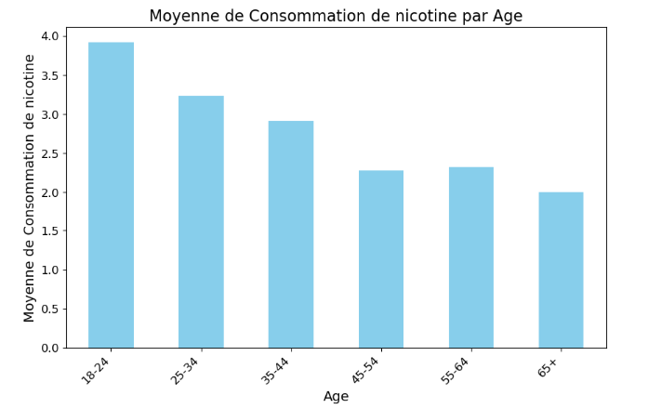
Bar Plot of Average Drug Consumption by Age

Slide 11
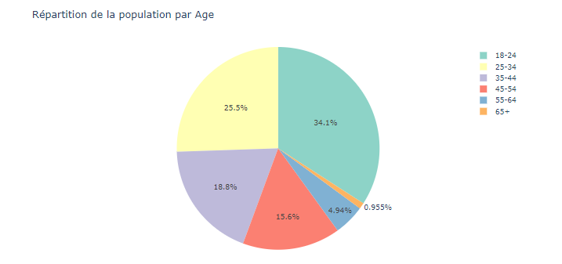
Pie chart of Population Distribution by Demographic Features

Slide 12
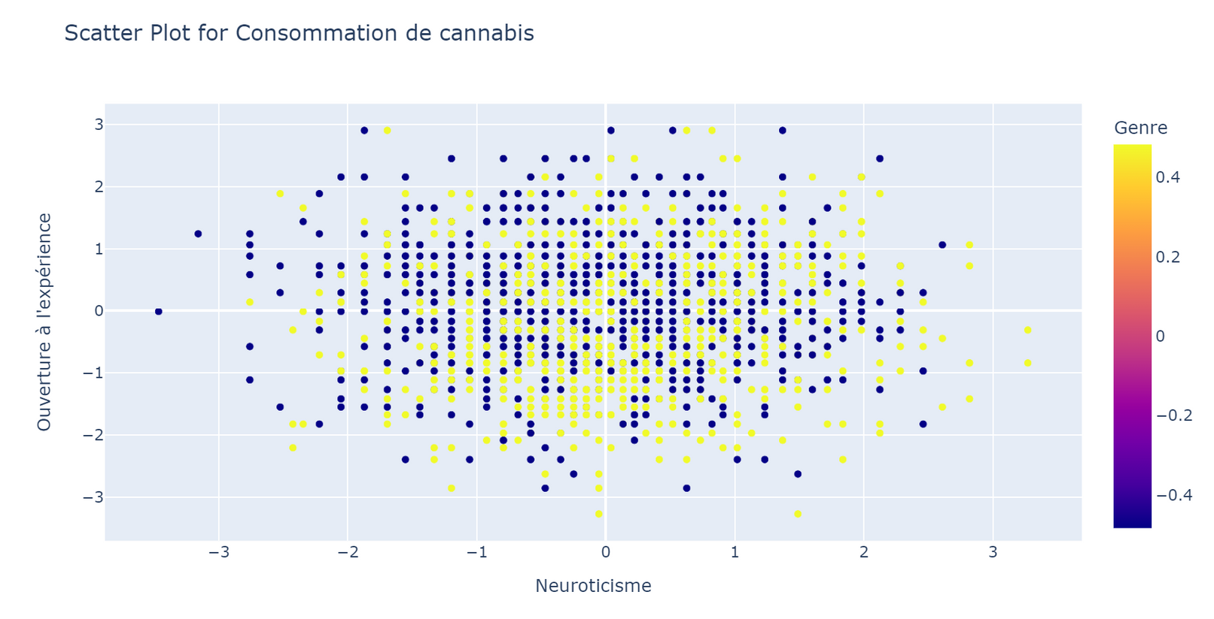
Scatter Plot for Specific Drug type

Slide 13
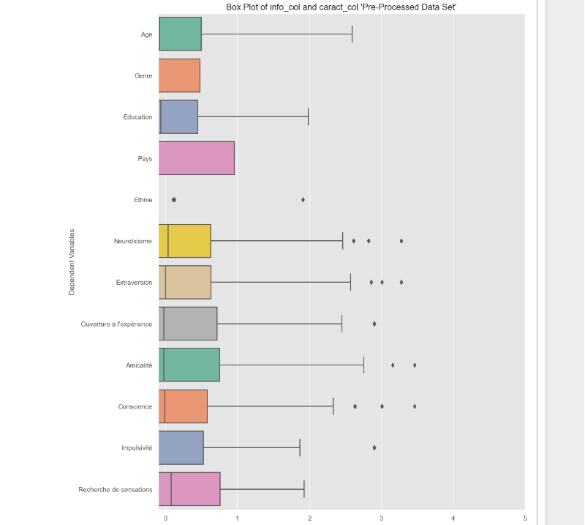
Box Plot of Pre-Processed Data features

Slide 14
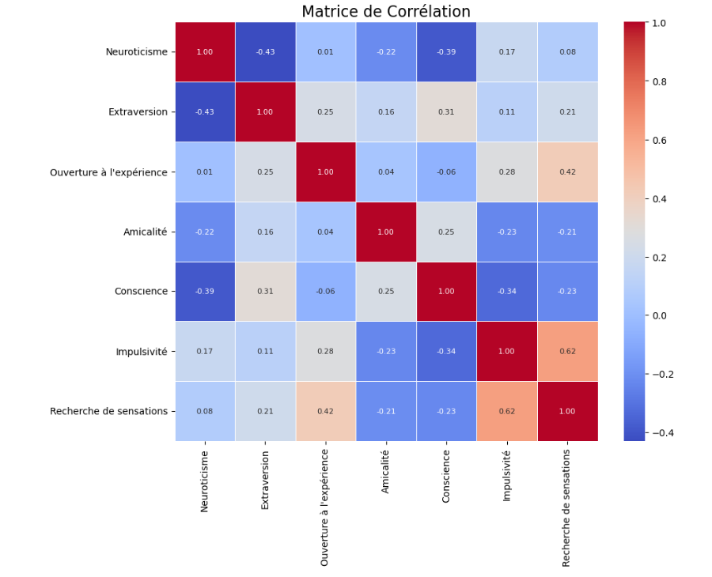
Correlation Matrice of personal traits

Slide 15
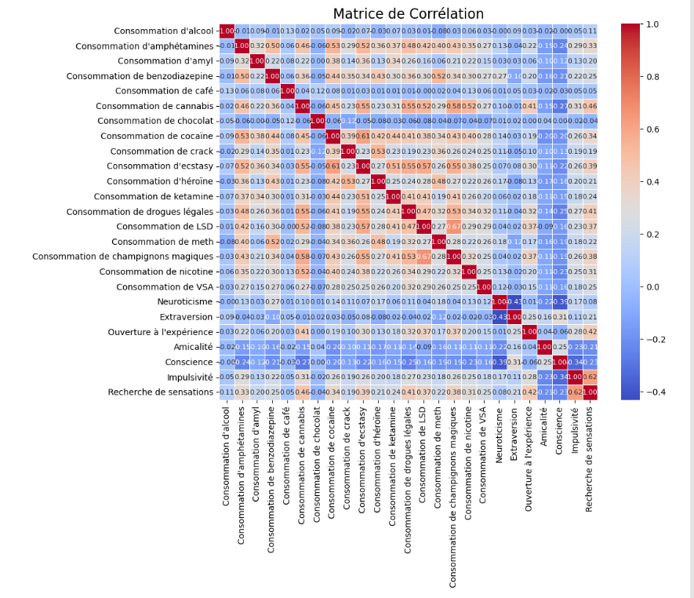
Correlation Matrice of drugs types and personal traits

Slide 16
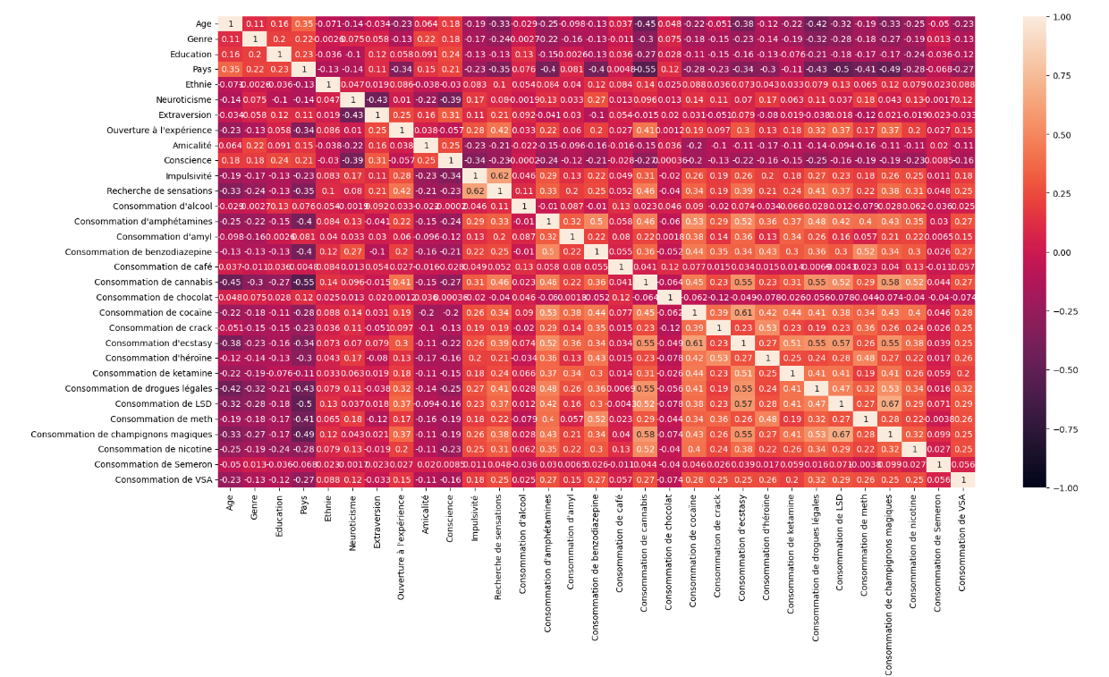
Heatmap of all features

Slide 17
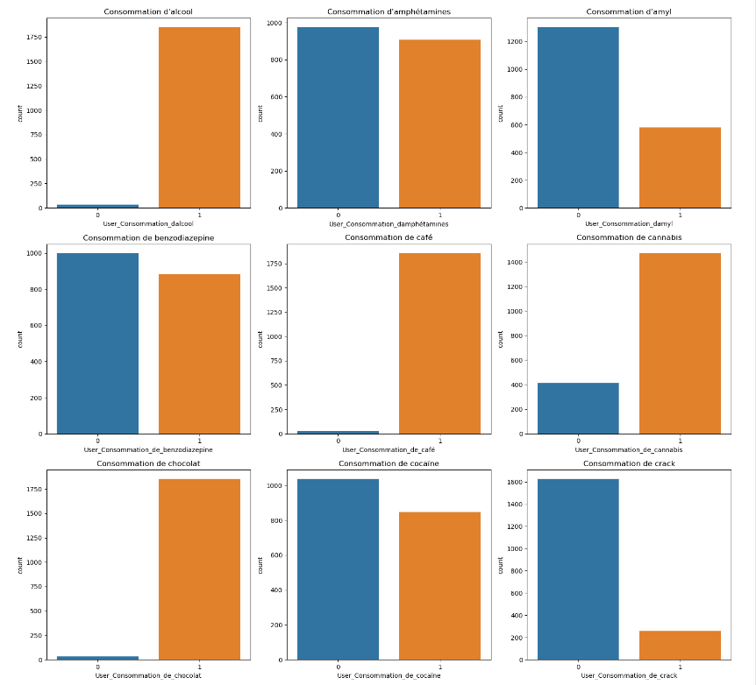
Function that returns a plot of Users vs Non-Users of all drugs each on it’s own plot

Slide 18
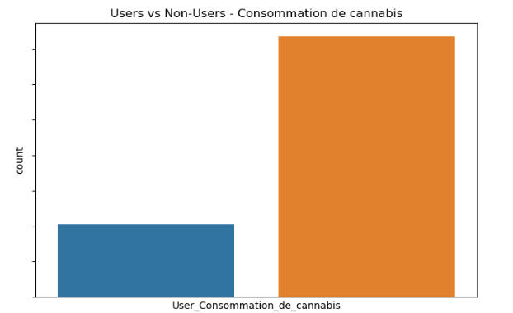
Function that returns a plot of Users vs Non-Users of a chosen drug

Slide 19
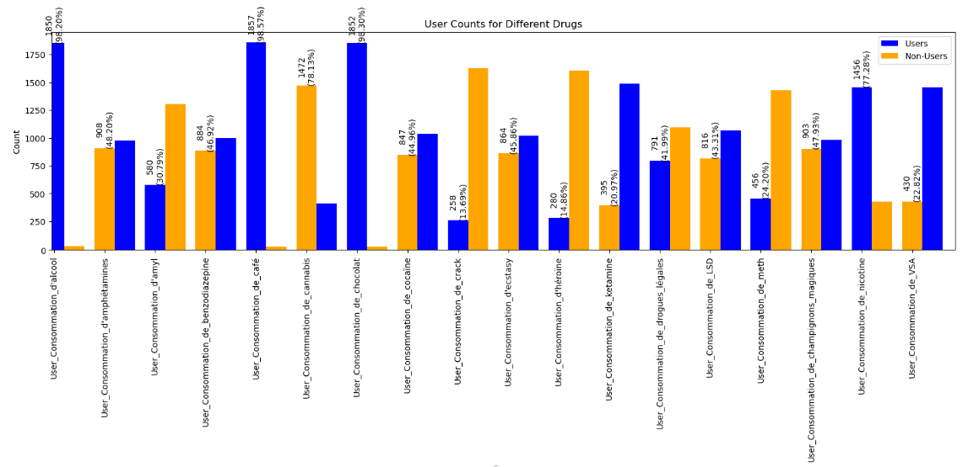
User vs Non-Users Counts for Different Drugs

Slide 20
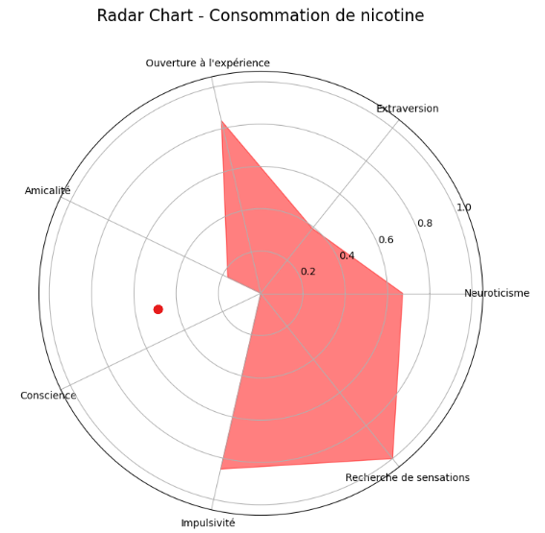
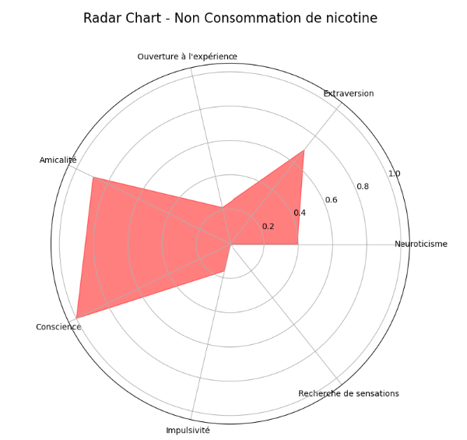
Radar Chart: Substance Consumption vs. Non-Consumption Based on Personality Traits

Slide 21
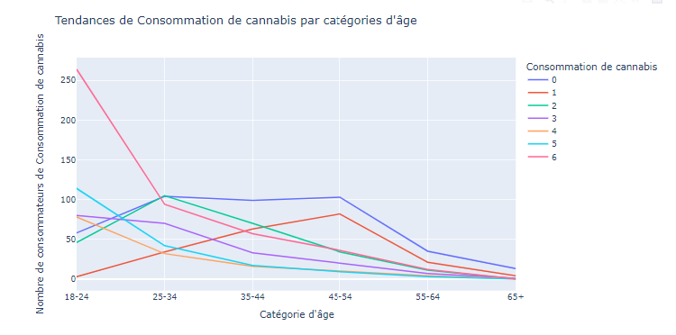
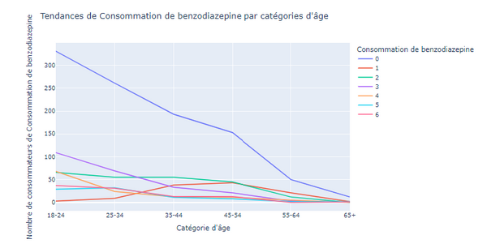
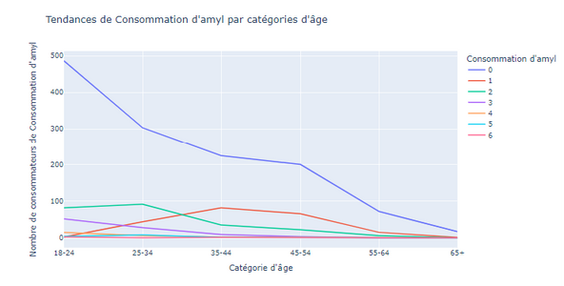
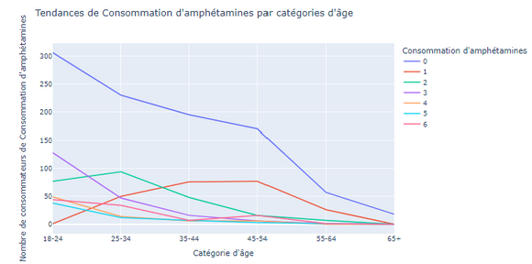
Consumption Trends of each drug Across Age Categories

Slide 22
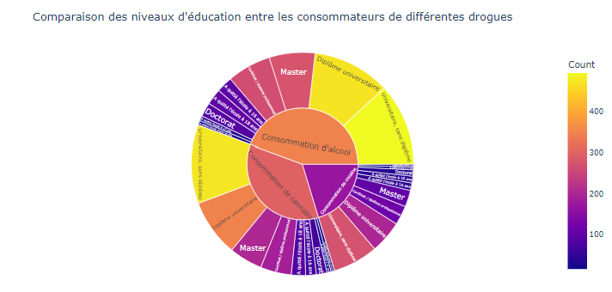
Comparison of Education Levels Among Consumers of Different Drugs
Notes:
drugs_to_analyze = ["Consommation de cannabis", "Consommation de cocaïne", "Consommation d'alcool"]
plot_education_level_sunburst(pers_data, drugs_to_analyze)

Slide 23
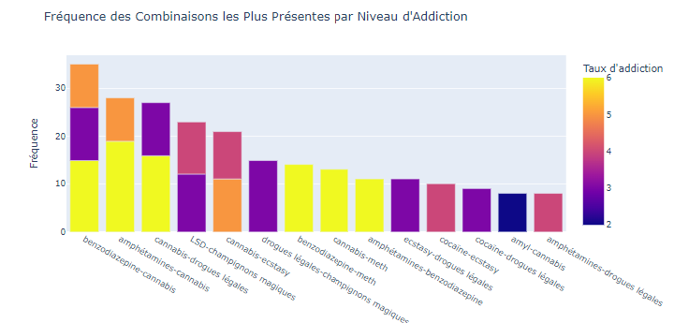
Frequency of Most Common Combinations by Level of Addiction

Slide 24
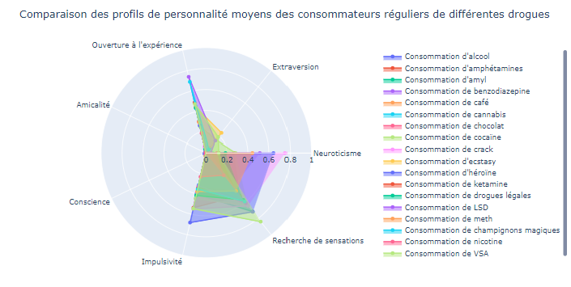
Comparison of Average Personality Profiles Among Regular Consumers of Different Drugs

Slide 25

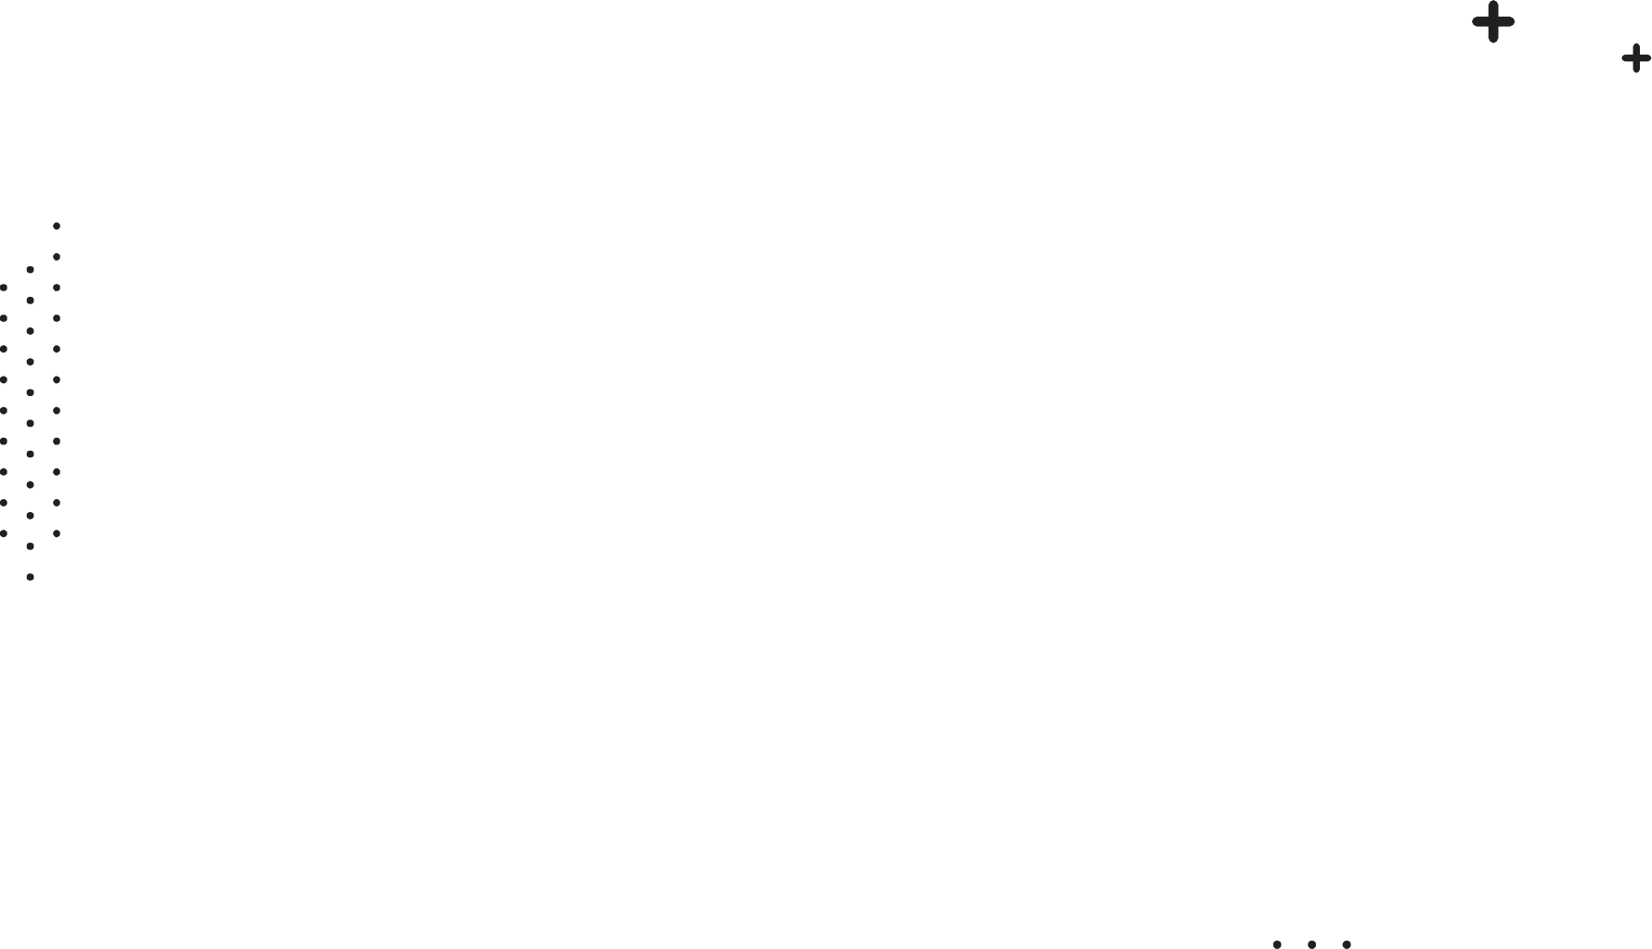

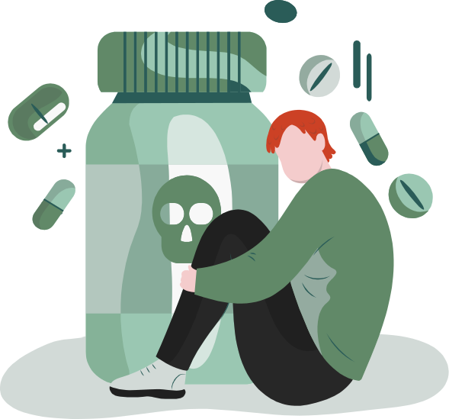
03
Modeling

Slide 26

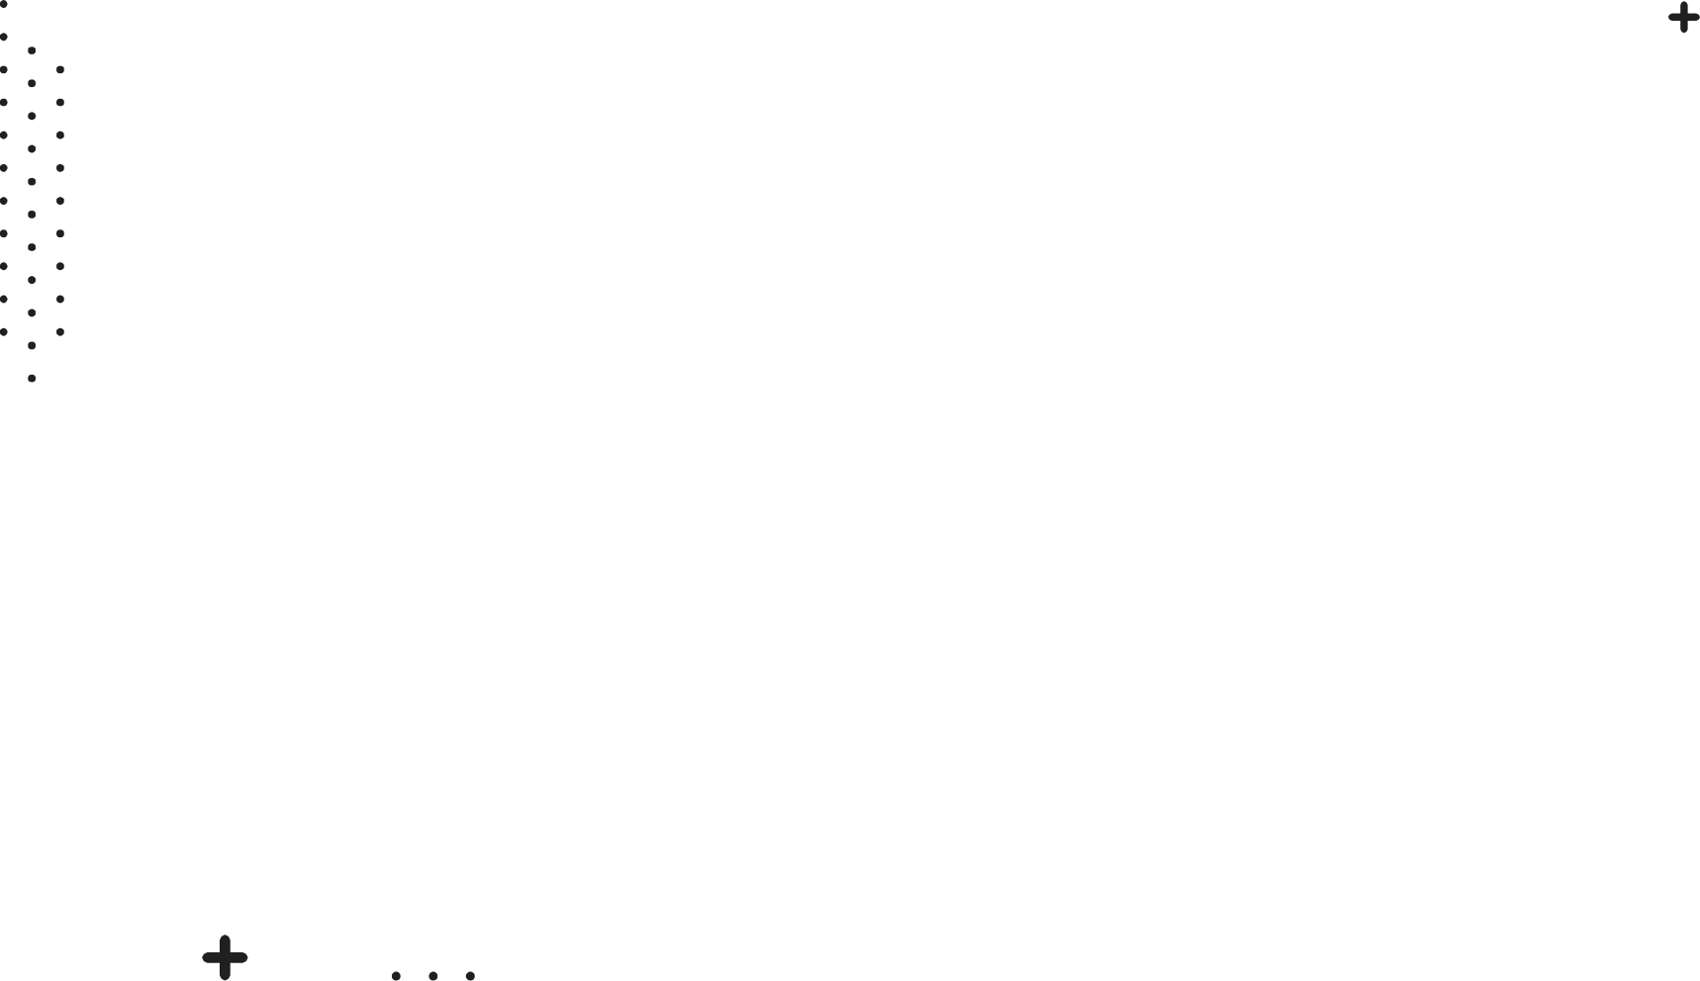
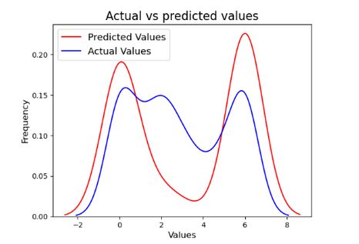
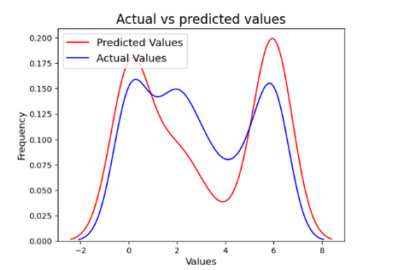
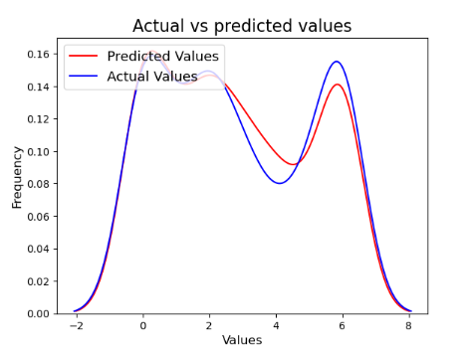
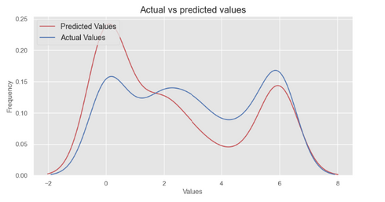
Strategy 1:
We trained our model only on demographic features and personnal traits features and we tried to predict the target feature
01
03
SVM:
Accuracy: 40.58%
02
Random Forest:
Accuracy: 39.26%
04
Decision Tree:
Accuracy: 29.18%
K-NN:
Accuracy: 33,56%

Slide 27
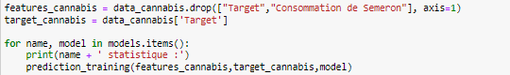
Strategy 2:
We trained our model on all features except one target features that we want

Slide 28
Strategy 3:
We trained our model on all features except one target features that we want

Slide 29

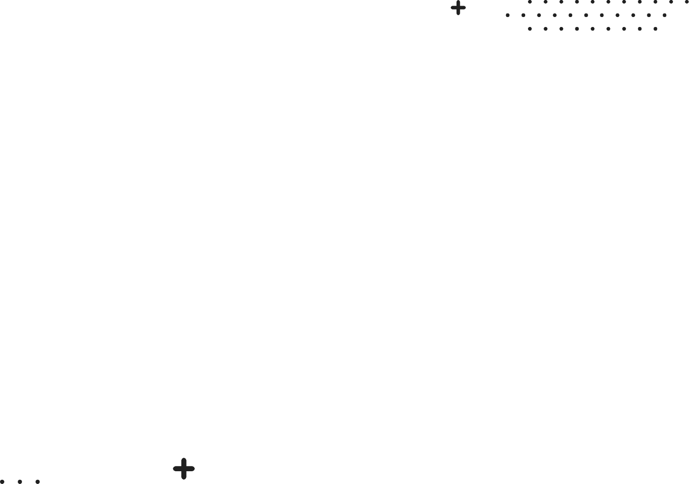
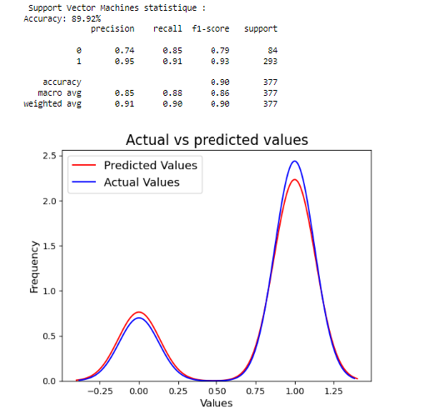

Algorithmes used:
SVM

Slide 30


Algorithmes used:
Decision Tree Classifier

Slide 31


Algorithmes used:
Random forest classifier

Slide 32

Definition of substance abuse
Mercury is the closest planet to the Sun and the smallest one in the entire Solar System. Contrary to popular belief, this planet's name has nothing to do with the liquid metal. Mercury was, instead, named after the famous Roman messenger god Mercurius
Mercury takes a little more than 58 days to complete its rotation, so try to imagine how long days must be there! Since the temperatures are so extreme, albeit not as extreme as on Venus, Mercury has been deemed to be non-habitable for humans

Slide 33



04
Bonus touch

Slide 34



New Data added:
Created a Google Form to systematically collect data on drug addiction among students at ESILV school.
Included questions covering demographic information, academic experiences, and various aspects of drug usage patterns to ensure a comprehensive analysis.
Implemented measures to guarantee participant anonymity and encouraged honest responses to enhance the reliability of the collected data.
Link: https://docs.google.com/forms/d/e/1FAIpQLSdciFpJZGCfMeNfpObE1PAqkZ1xhai-3oQ-YtlxN-QbyVXzig/viewform?usp=pp_url

Slide 35


05
API

Slide 36

Streamlit:
Link: https://docs.google.com/forms/d/e/1FAIpQLSdciFpJZGCfMeNfpObE1PAqkZ1xhai-3oQ-YtlxN-QbyVXzig/viewform?usp=pp_url

Slide 37





06
Conclusions

Slide 38

A picture is worth a thousand words
"Don't consume drugs! Opt for coffee and chocolate instead.”

Slide 39





Do you have any questions?
PS: In case this is your question
No, i don’t sell any kind of drugs

